Slide 1

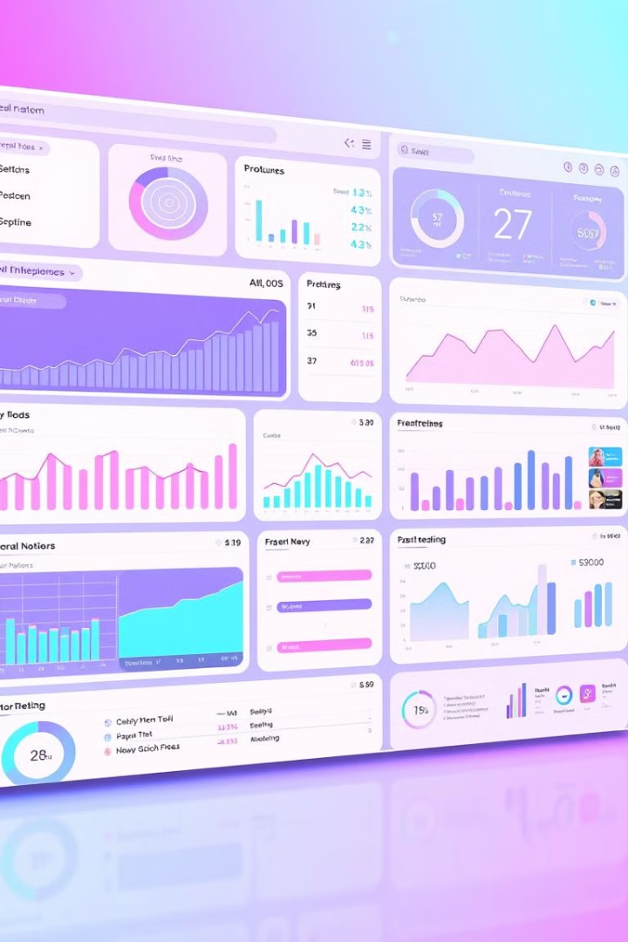


Data-Driven Insights: Shaping the Future
In today's data-driven world, insights are crucial for informed decision-making. This presentation explores the most demanded projects and their impact on the future.
by Gayathri Harika

Slide 2

Demanded Projects in the Current World
1
Artificial Intelligence (AI)
2
Cybersecurity
AI is revolutionizing various industries, from healthcare to finance, with applications like machine learning and natural language processing.
As cyber threats increase, demand for cybersecurity professionals and solutions continues to grow.
3
Cloud Computing
4
Data Analytics
Cloud computing provides scalable and flexible infrastructure, making it essential for businesses of all sizes.
Data analytics plays a critical role in extracting valuable insights from massive datasets, enabling data-driven decision-making.

Slide 3
Project 1: AI-Powered Healthcare
Key Benefits
Impact on the Future
AI-powered diagnostics can improve accuracy and efficiency. Personalized medicine tailored to individual needs. Drug discovery and development accelerated by AI algorithms.
Improved patient outcomes and reduced healthcare costs. Predictive analytics for early disease detection. AI-powered robots assist with surgery and rehabilitation.

Slide 4
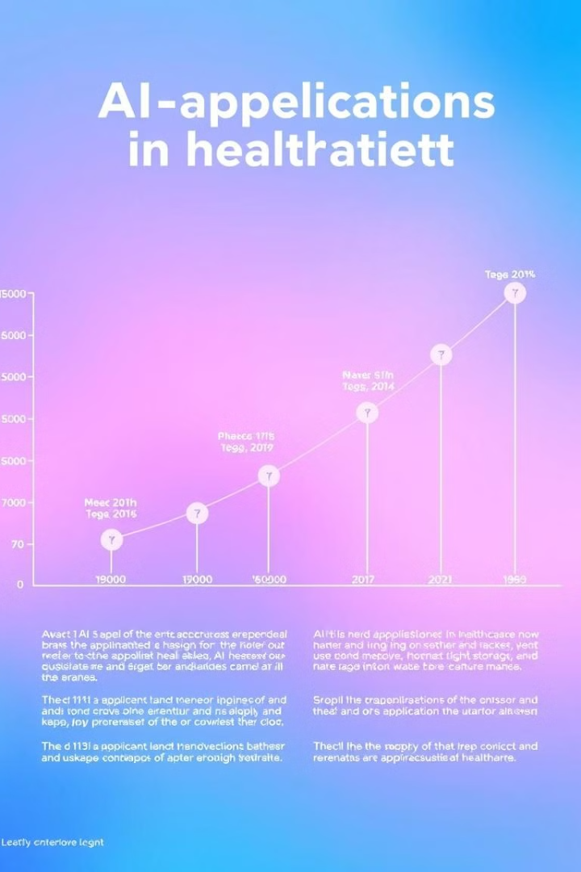
Key Insights and Trends
1
Increased Adoption
AI technologies are being widely adopted in hospitals and clinics.
2
Data Security Concerns
Ensuring privacy and security of sensitive patient data is paramount.
3
Ethical Considerations
Addressing ethical considerations surrounding AI in healthcare is crucial.

Slide 5

Impact on the Future
Telemedicine
Personalized Treatment Plans
AI enables remote consultations and monitoring, improving accessibility.
AI analyzes patient data to create individualized treatment plans.
Drug Development
AI accelerates the process of drug discovery and development.

Slide 6

Project 2: Cybersecurity for Critical Infrastructure
Threat Landscape
Increasingly sophisticated cyber attacks target critical infrastructure.
Vulnerabilities
Outdated systems and lack of security measures create vulnerabilities.
Consequences
Disruptions to essential services, economic damage, and national security risks.

Slide 7




Key Insights and Trends
Proactive Defense
Implementing preventative measures to mitigate threats.
Threat Intelligence
Gathering information about emerging threats and vulnerabilities.
Security Automation
Automating security tasks for faster response times.

Slide 8

Conclusion: Leveraging Data to Drive Innovation
Data-driven insights are essential for informed decision-making and innovation. By leveraging data analytics and AI, we can address critical challenges and shape a better future.

